Slide 1
Flipkart Reviews Sentiment Analysis using Python
Presented by : www.clcoding.com

Slide 2
Project Aim
Flipkart is one of the most popular Indian companies. It is an e-commerce platform that competes with popular e-commerce platforms like Amazon.
One of the most popular use cases of data science is the task of sentiment analysis of product reviews sold on e-commerce platforms.
So, if you want to learn how to analyze the sentiment of Flipkart reviews, this article is for you. In this article, I will walk you through the task of Flipkart reviews sentiment analysis using Python.

Slide 3
Library / Algorithm used
Pandas
Seaborn
Matplotlib
nltk.sentiment.vader
Wordcloud

Slide 4
Steps/ part of the project
Importing the necessary Python libraries and the dataset:.
Cleaning the data.
Preparing review column.
Analyzing the sentiments.
Getting the final output.

Slide 5
Code
We will see the code in interpreter

Slide 6
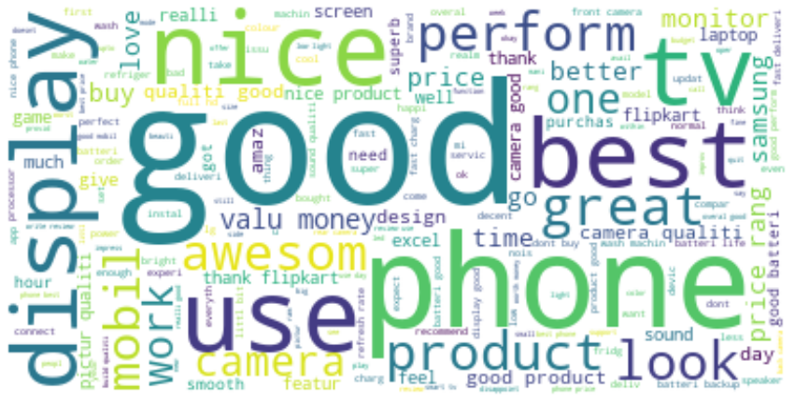
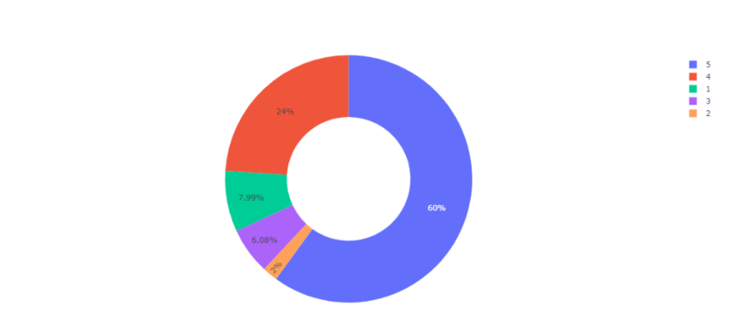
Output

Slide 7
Summary
So this is how you can use the Python programming language to perform sentiment analysis review in python.
We checked whether the people are satisfied with Flipkart products or not and got the output for the same.
I hope you liked this article on Flipkart review sentiment analysis.
Feel free to ask valuable questions in the comments section below.

Slide 8
Thank You!

